Slide 1

ADA REGRESSION

Slide 2
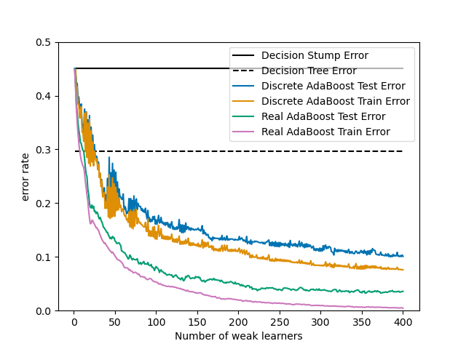

Slide 3
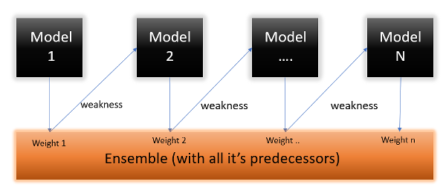

Slide 4
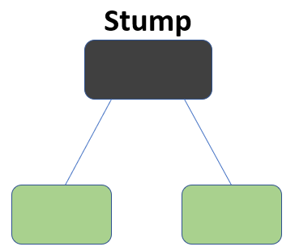
AdaBoost is decision trees with one level which means Decision trees with only 1 split. These trees are also called Decision Stumps

Slide 5

The formula to calculate the sample weight is

